Slide 1


Topic : A Smart Healthcare Platform Domain : Health Team ID : 131 Team name : winks Team members : 2303A51530 :2303A51442

Slide 2
Problem Statement
Smart Healthcare Platform – Virtual Health Assistant
Purpose:
To bridge the healthcare accessibility gap for students, young adults, and individuals in rural or semi-urban areas by providing an AI-powered virtual health assistant.
Main Goals & Expected Outcomes:
AI-Based Symptom Analysis – Users can input symptoms and receive preliminary health suggestions.
Easy Access to Healthcare – Locate nearby hospitals/clinics and book online or in-person appointments.
Telemedicine Support – Consult doctors via video calls or chat for remote healthcare access.
Personal Health Tracker – Monitor vital health metrics and track wellness trends.
Medication & Wellness Reminders – Get notified about medications, check-ups, and health routines.
Mental Health Support – Mood tracking, stress management resources, and access to professional help.
Educational Resources – Promote health awareness with articles, videos, and expert insights.
Secure & Private – All data is encrypted to ensure user confidentiality and safety.

Slide 3
Existing system
Current Healthcare System & Its Limitations
1. Current System in Use
Traditional healthcare relies on physical hospital visits, local clinics, and manual appointment booking.
Basic symptom checking is done through self-assessment or consultation with a doctor.
Mental health support is often limited or inaccessible in rural/semi-urban areas.
2. Limitations & Inefficiencies
Delayed Diagnosis – Lack of early symptom assessment leads to worsening conditions.
Limited Accessibility – Many people in remote areas lack access to proper medical facilities.
Appointment Hassles – Long wait times and difficulty in scheduling doctor visits.
Lack of Awareness – Many individuals lack knowledge about preventive healthcare and wellness.
Mental Health Neglect – Inadequate resources for mental health support and awareness.
3. Need for a New System
A smart healthcare platform is essential to provide instant health guidance, remote consultations, and easy access to medical services for underserved populations.
Digital solutions can enhance healthcare efficiency, reduce delays, and improve overall well-being.
4. Comparative Table
FeatureTraditional HealthcareSmart Healthcare PlatformSymptom AssessmentManual, delayedInstant AI-based analysisAccessibilityLimited in remote areasAvailable anywhere
.

Slide 4
Proposed system
1. Introduction
The Smart Healthcare Platform is an AI-powered mobile and web application designed to enhance healthcare accessibility for students, young adults, and underserved communities. It provides instant health assessments, online doctor consultations, and mental health support, bridging the gap between users and medical professionals.
2. Advantages Over the Existing System
Faster Diagnosis – AI-based symptom checking reduces delays.
Remote Accessibility – Users can consult doctors online without visiting a clinic.
Convenient Appointments – Easy booking system for consultations.
Mental Health Support – Built-in mood tracking and wellness resources.
Personalized Health Tracking – Monitors vital signs and reminds users of medications.
3. Key Features & Functionalities
AI-Powered Symptom Checker – Provides health suggestions based on user input.
Hospital & Doctor Search – Helps locate nearby medical facilities.
Telemedicine Support – Enables video consultations with healthcare professionals.
Personal Health

Slide 5
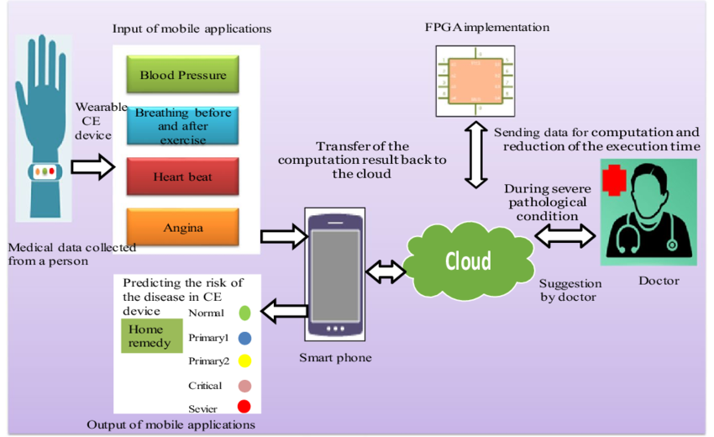
Workflow

Slide 6
System Architecture
Tech Stack
Key points to cover
Languages used (java)
Show the system’s technical structure.
Use a layered or block diagram.
Label different components and their interactions.
Keep the explanation brief and precise.
Maintain a clean and organized layout.
Online java compliar
Database security
Cloud service used for hosting
API’s used
Diagram analysis of final Output

Slide 7
Conclusion & Future Scope
The Smart Healthcare Platform is a mobile and web-based application designed to make healthcare more accessible, efficient, and user-friendly. It provides AI-driven symptom analysis, telemedicine support, mental health resources, and personal health tracking, addressing the challenges faced by students, young adults, and individuals in underserved areas.
Notes:
The Smart Healthcare Platform is a mobile and web-based application designed to make healthcare more accessible, efficient, and user-friendly. It provides AI-driven symptom analysis, telemedicine support, mental health resources, and personal health tracking, addressing the challenges faced by students, young adults, and individuals in underserved areas.
Impact & Benefits:
Quick Health Insights – AI-powered symptom checker helps users make informed decisions.
Easy Access to Healthcare – Locate hospitals, book doctor appointments, and consult online.
Mental Health Support – Includes mood tracking, guided exercises, and professional resources.
Health Tracking & Reminders – Monitor vitals and receive medication and wellness notifications.
Privacy & Security – Ensures encrypted data storage and confidentiality.

